Slide 1
Unit- 3 Design and Development
Dr. Madhukrishna Priyadarsini
Department of CSE

Slide 2
Outline:
Embedded computing logic(microcontroller, system on chip)
IoT system building blocks
Board details(Raspberry Pi, Arduino)
IDE programming (Raspberry Pi with python programming)

Slide 3
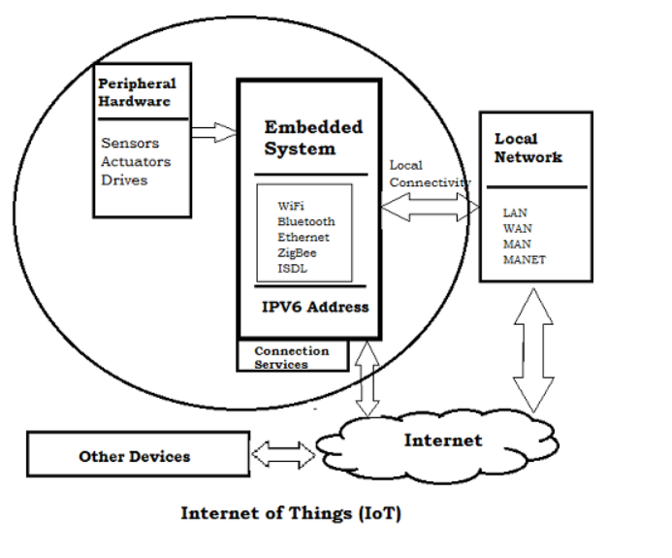
Embedded computing logic
Key components of Embedded systems are:
Microprocessor/Microcontroller
Memory
Networking units
Input/output units
Storage

Slide 4
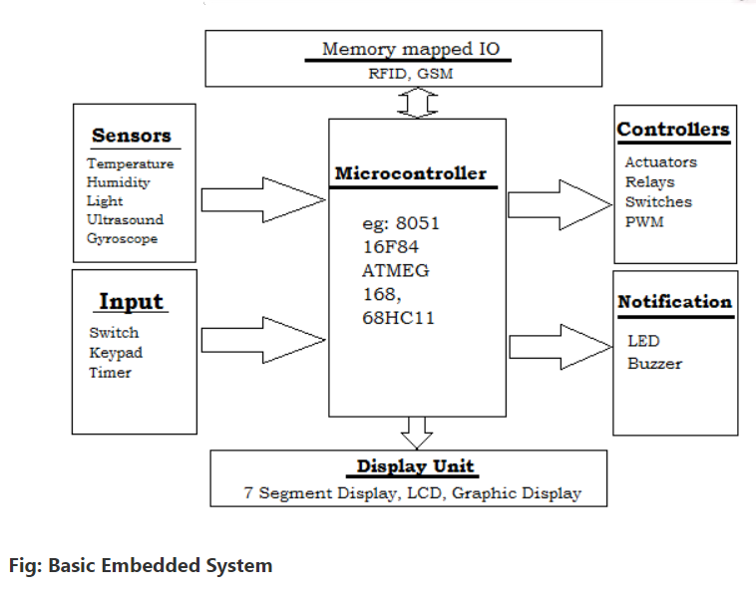
Ex: lighting control microcontrollers to aeroplanes and missiles
Emertia.OS

Slide 5
Microcontrollers
System-on-chip(SoC)
MCU | SoC
Contains a single chip with non-specific peripherals | Contains a multiple chips with specific peripherals
Intended for small control applications with low complexity | Intended for applications with more requirements and higher complexity
No OS involved | OS is integrated
Memory is minimal (in KB) | Memory is included in GB
External storage varies from KB to MB via Flash | External storage varies from MB to TB via SSD or HDD
Computing width is 8 bit, 16 bit, 32 bit | Computing width is 16 bit, 32 bit, 64 bit
Applications: Household appliances, Industrial instruments | Applications: smart phones, network routers, game console emulators
Product includes microchip technology 8051, Amtel MCU, PIC | Product includes Cypress PSoC, Qualcomm Snapdragon

Slide 6
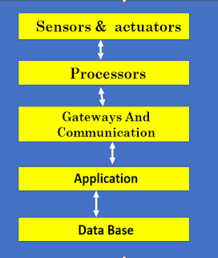
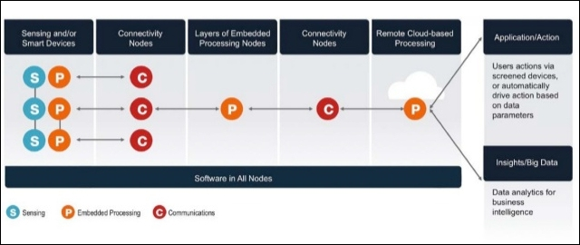
IoT system building blocks

Slide 7
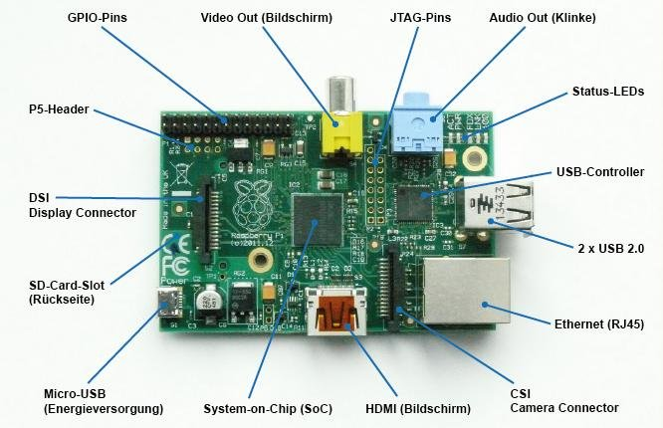
Board Details: Raspberry Pi

Slide 8
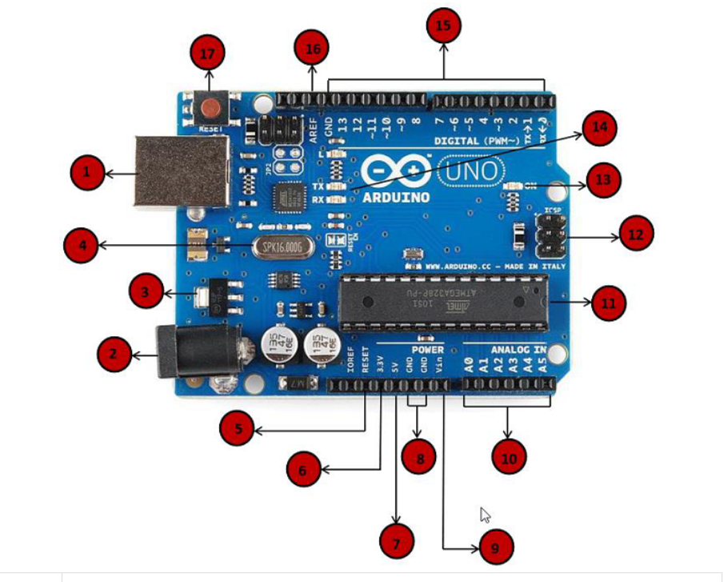
Board Details: Arduino

Slide 9
Power USB-> Power supply using USB cable
Power barrel jack-> Power supply from AC power supply
Voltage regulator-> Controls the voltage provided to the board
Crystal oscillator-> Helps to calculate time
17. Arduino reset-> Resets the board(pin 5 also resets)
6,7, 8,9. Pins-> 3.3v, 5v, GND, Vin
10. Analog pins-> Reads from analog sensor and converts to digital sensor(A0 through A5)
11. Main microcontroller-> Brain of the board
12. ICSP pin-> Serial peripheral interface
13. Power LED indicator-> Indicates power supply
14. Tx and Rx LEDs-> Transmit and receive signals
15. Digital I/O-> 14 digital I/O pins
16. AREF-> Analog reference voltage

Slide 10
Raspberry Pi using python programming
Controlling LED with Raspberry Pi
Interfacing an LED and switch with Raspberry Pi
Interfacing sensors with Raspberry Pi (RFID, motion)
Interfacing buzzer with Raspberry Pi

